Slide 1
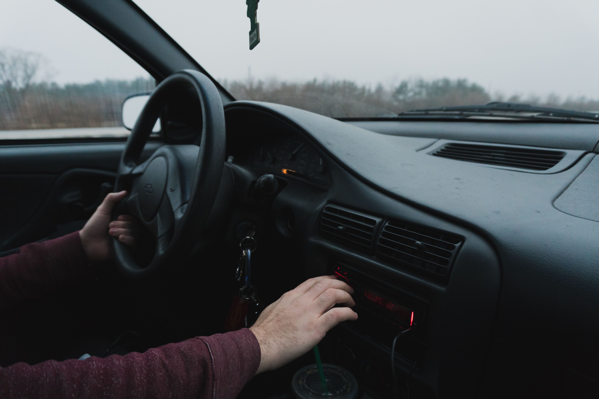
Boodal.
Varokah_Dev

Slide 2
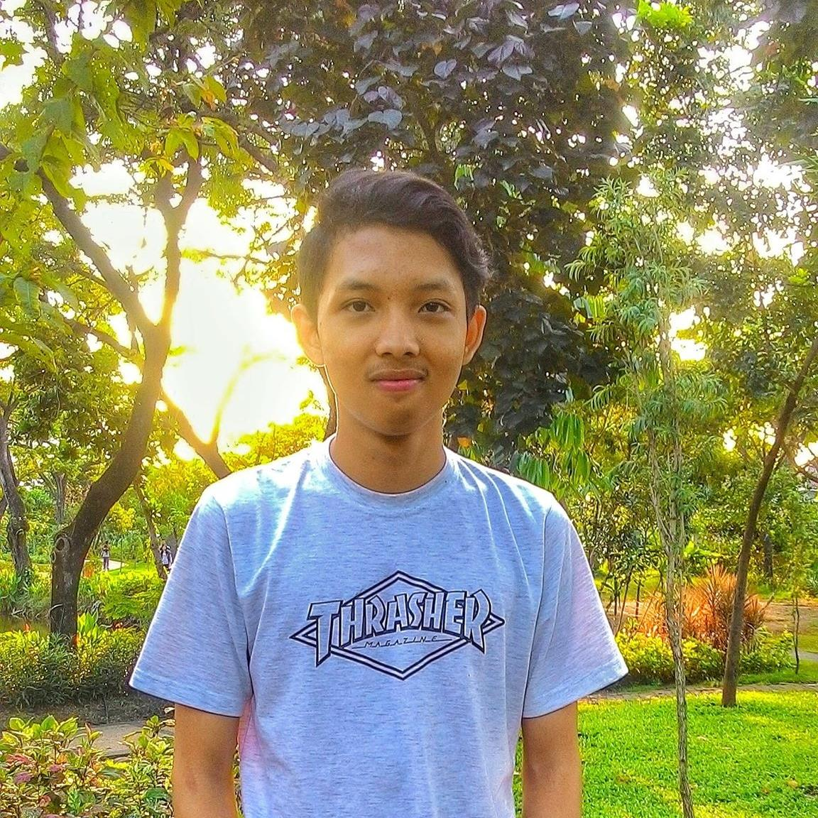

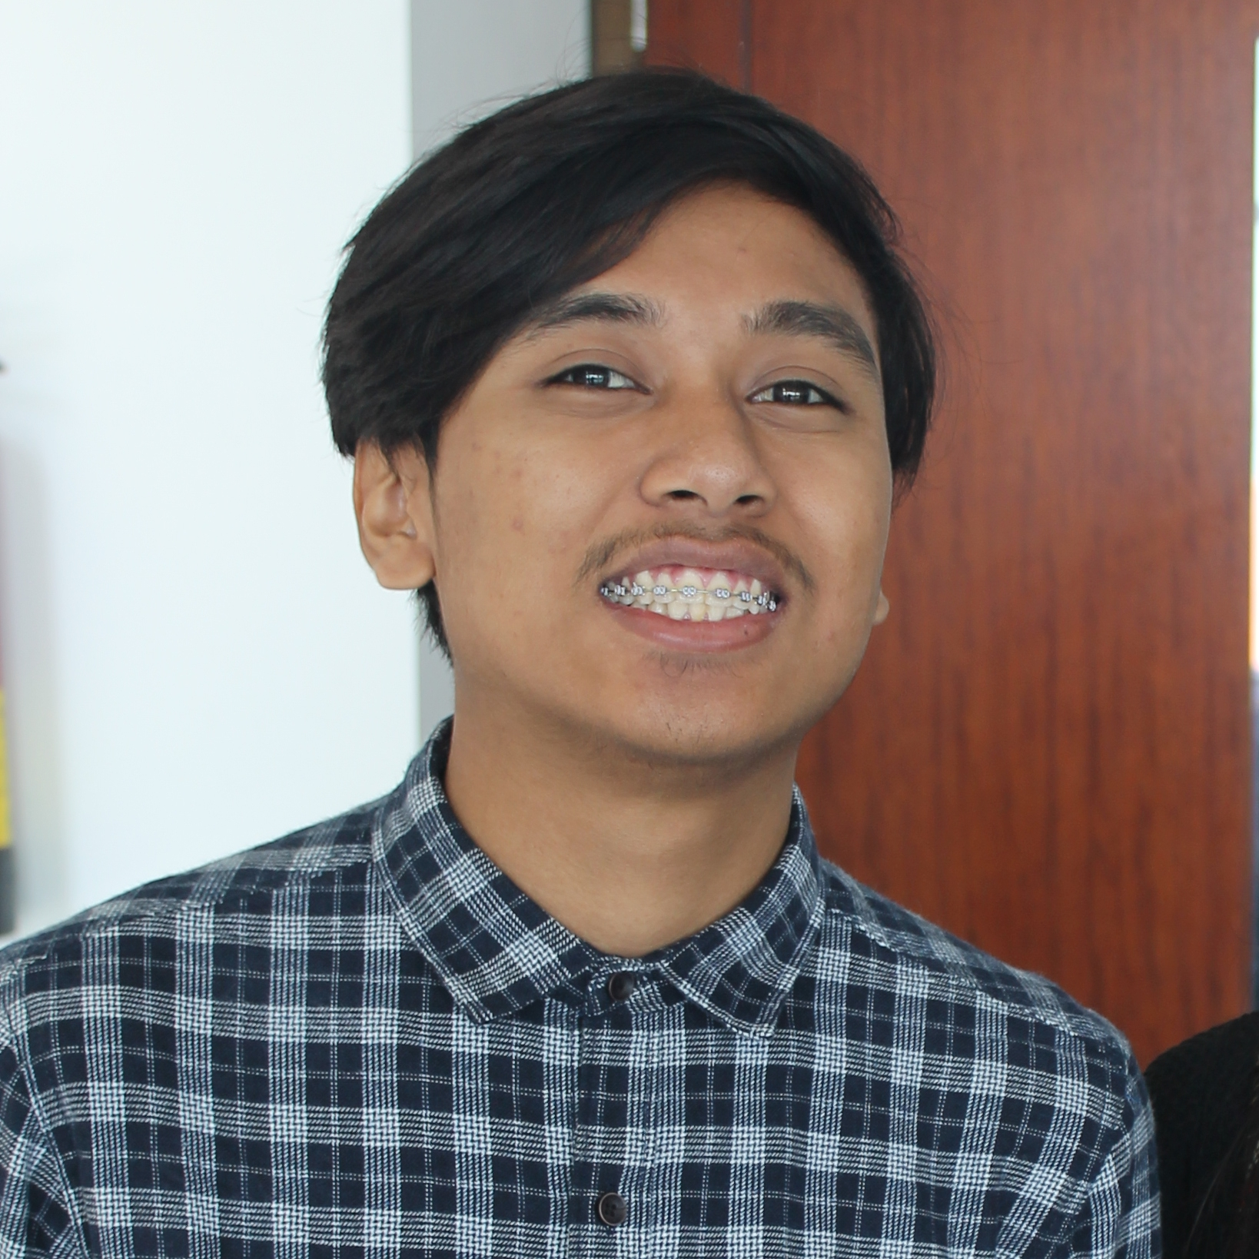
Our Team
Dicky Eka
Ariel Rakadewa
Fahmy Habibullah
BACKEND DEVELOPER
ANDROID DEVELOPER
UI/UX DESIGNER
With 2 years experience in web development, Dicky plays an important role about database & system of boodal
With 1 years experience in Android Development, Ariel responsible for all Android service & feature of boodal.
With over 1 years experience in Frontend Development & UI/UX Design. Fahmy makes a beautiful interface and nice UX of boodal.

Slide 3
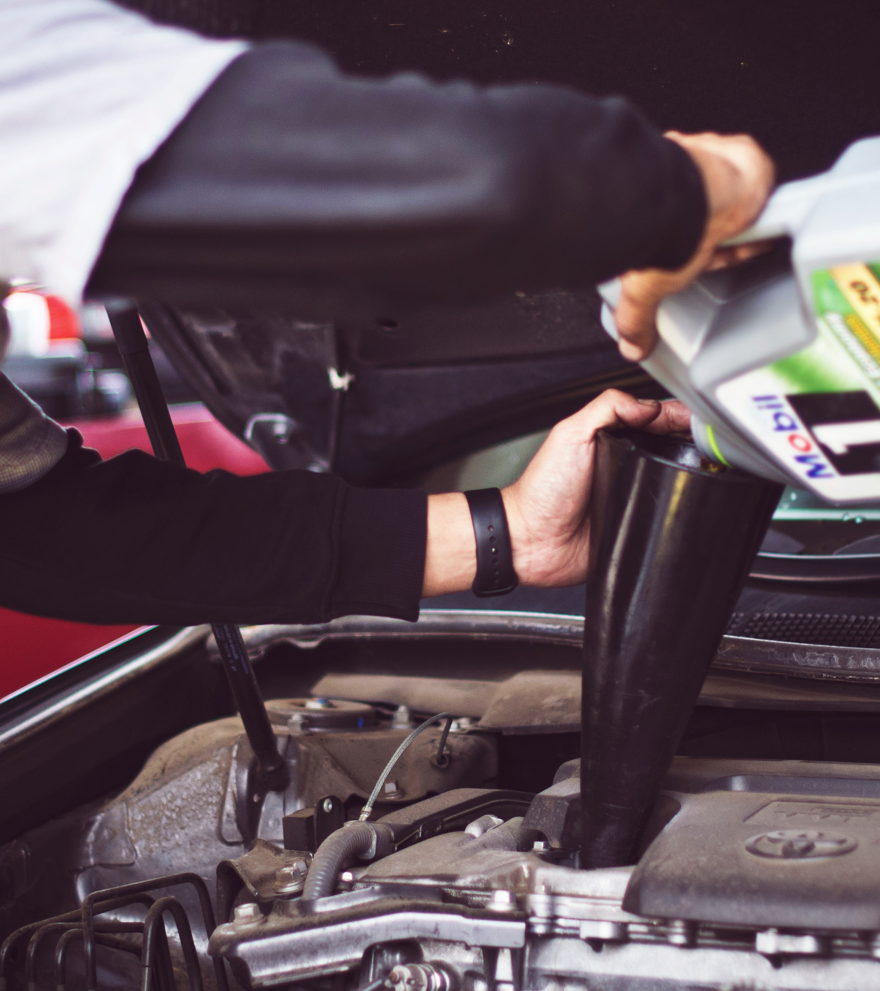
Why we make a boodal?
There are many variations problem on the road, starting breaking down of vehicle machine, losing your key, runs out of fuel, etc. And we need a help. With boodal you helped with professionals mechanic and makes your trip still fun :D

Slide 4





Boodal Service
You can discover and order automotive services starting from car automotive service, tire repairs, refuel, towing your car and loss your key of vehicle

Slide 5
Car Automotive Services
JOIN OUT MAILING LIST
if you are traveling a far away and you do not know the nearest mechanic, looking at this service
READ MORE

Slide 6
Tire
Repairs
JOIN OUT MAILING LIST
if you are traveling a far away and you do not know the nearest tire mechanic, looking at this service.
READ MORE

Slide 7
Locksmith
Finder
JOIN OUT MAILING LIST
if you are traveling a far away and you do not know the nearest locksmith in your location, looking at this service.
READ MORE

Slide 8
Towing
Service
JOIN OUT MAILING LIST
If you are traveling far and your vehicle breaking down and then you get confused do not know where to find a tow truck. And want to tow your car. Find in this service
READ MORE

Slide 9
Towing
Service
JOIN OUT MAILING LIST
if you are traveling far and your vehicle runs out of fuel. Find in this service
READ MORE

Slide 10
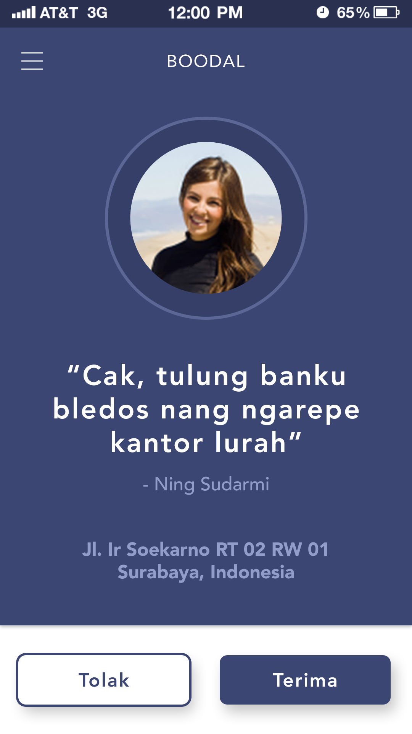
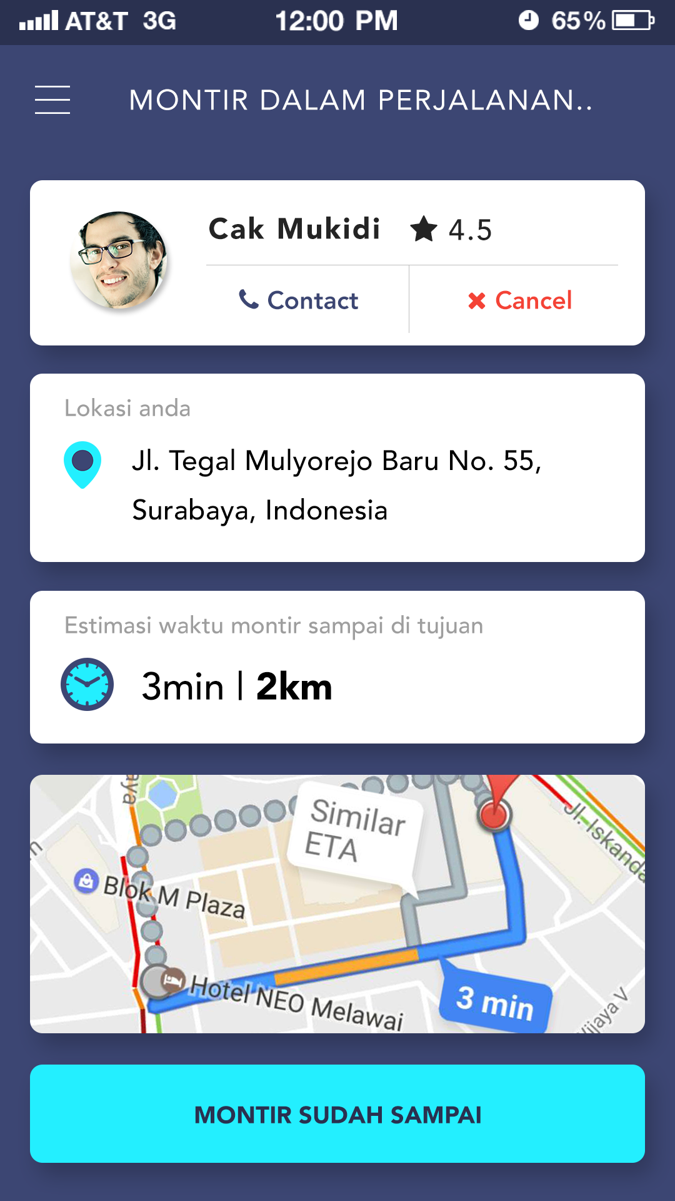
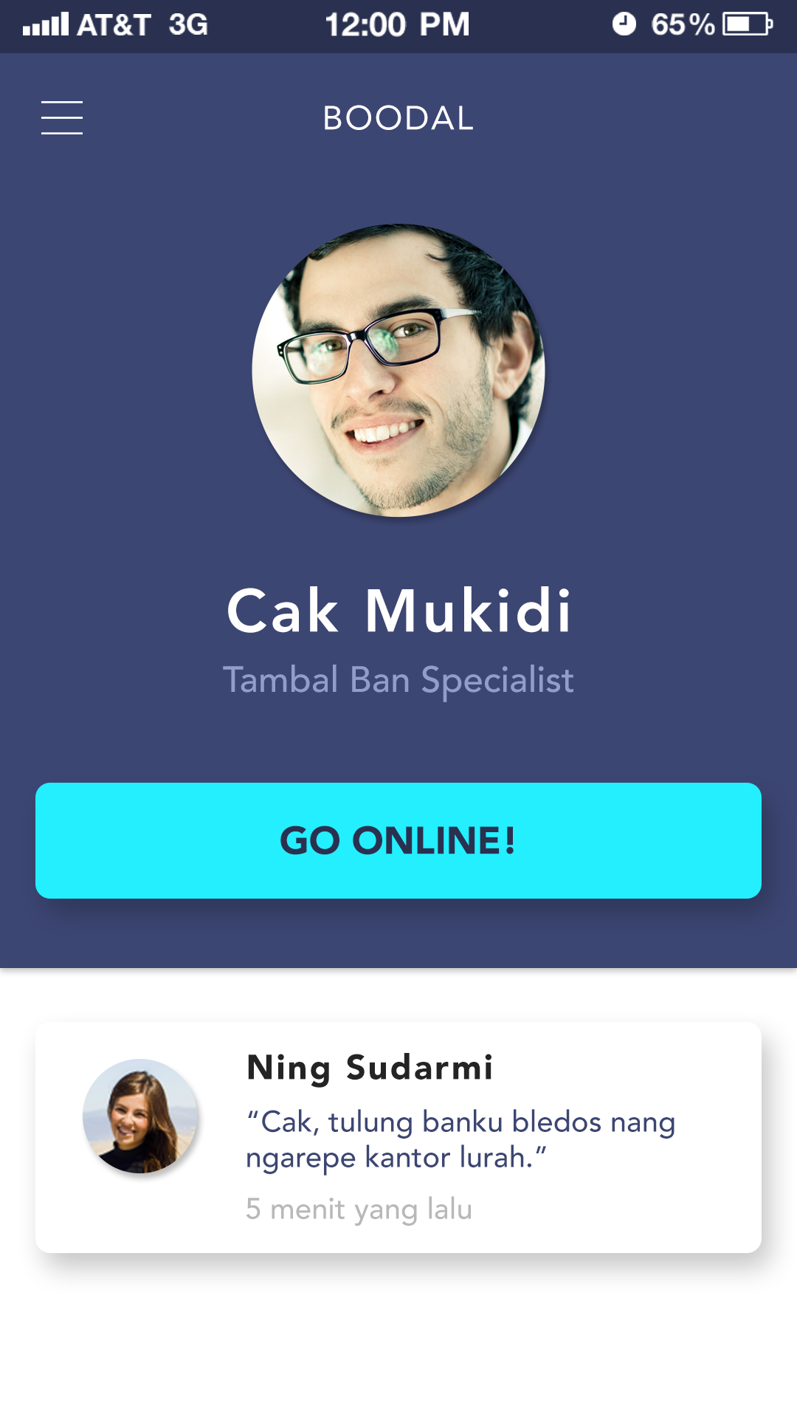
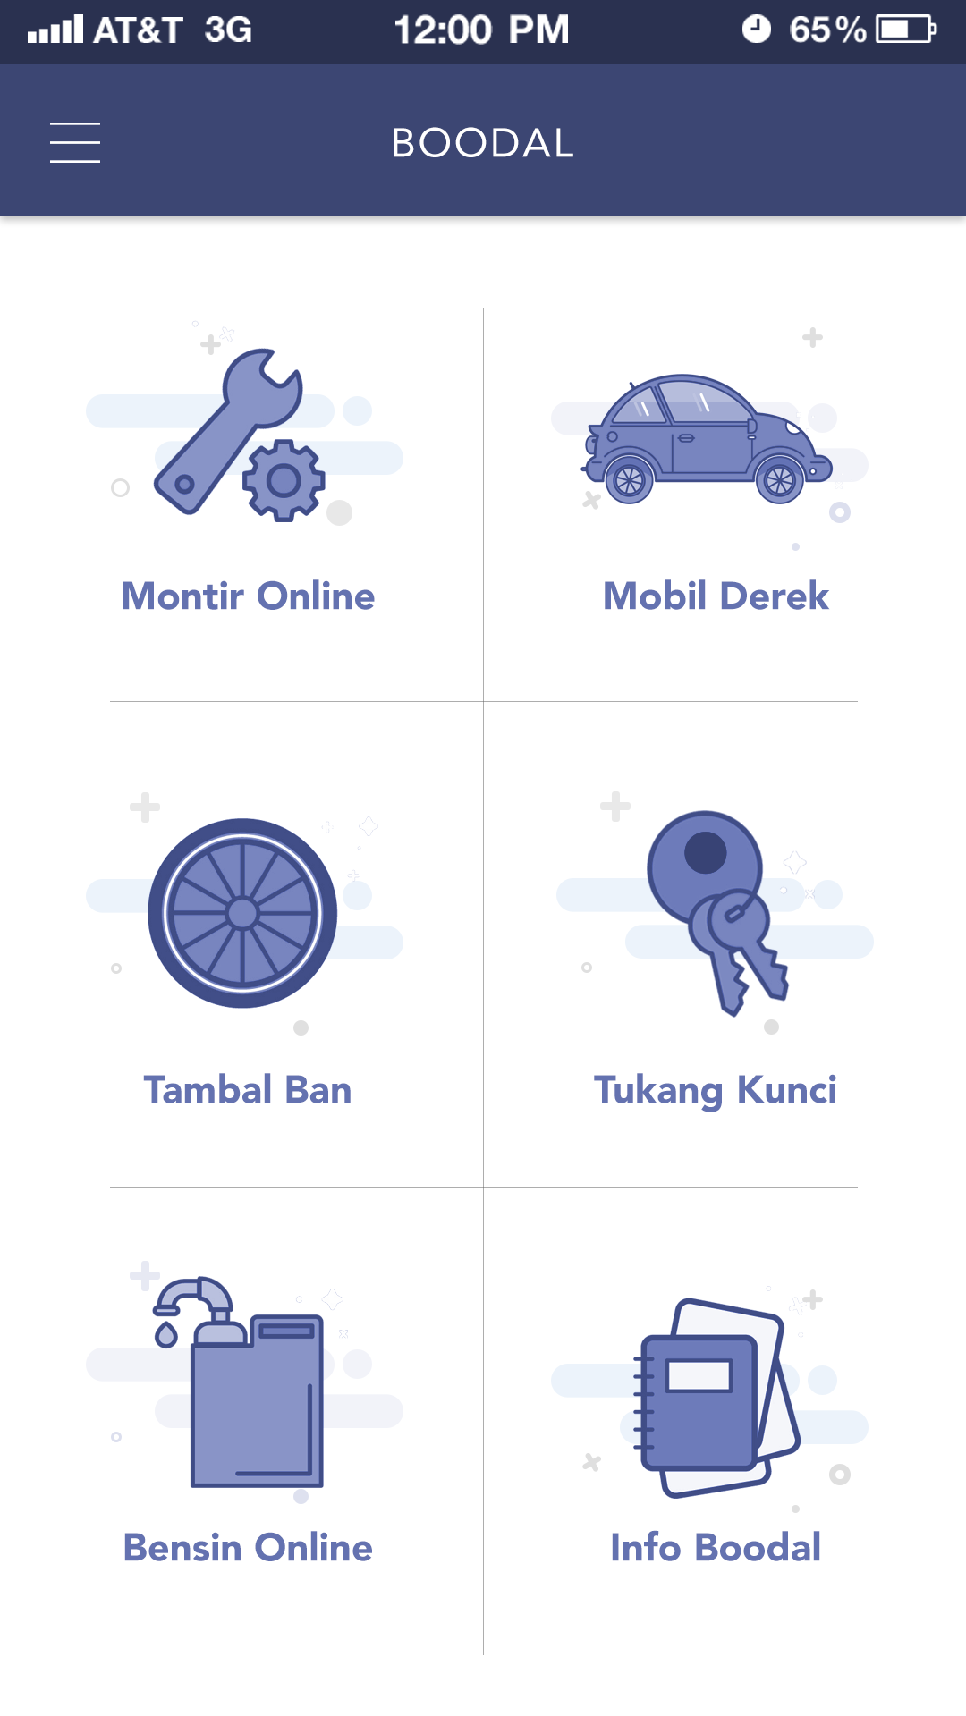
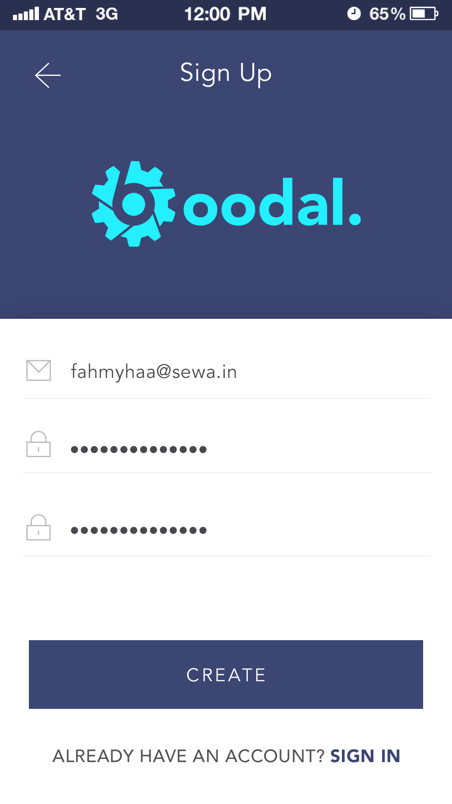
Varokah_dev
Isometric
UI Design of Boodal
With beautiful interface and nice user experience making boodal is your vehicle assisstant of your trips

Slide 11
Thank You.

